Slide 1

Data Visualization Techniques & Best Practices
Why visualization matters in data science

Slide 2
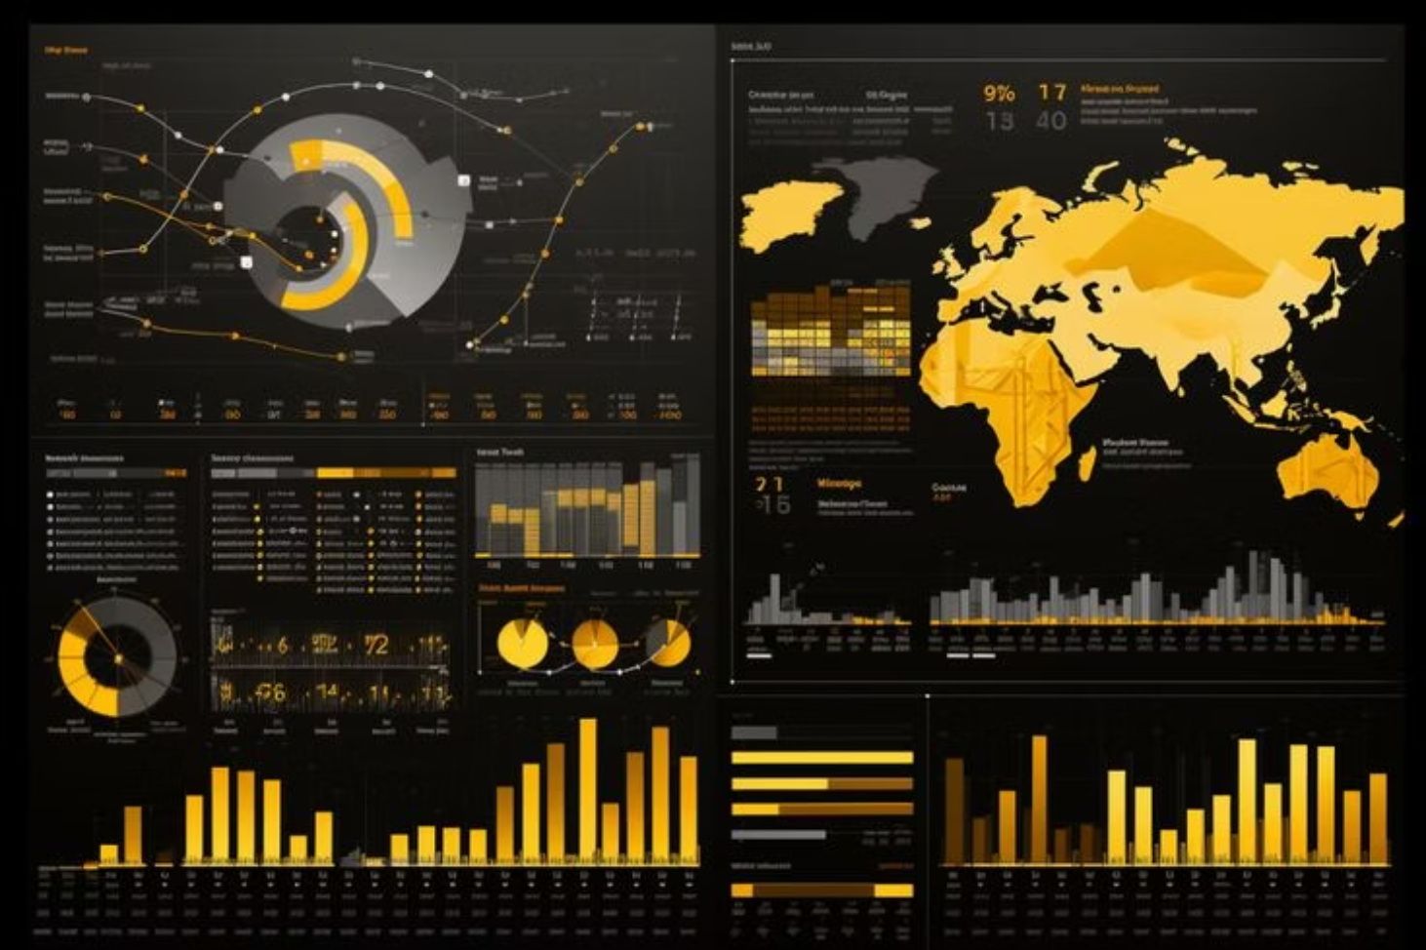
What Is Data Visualization?
Data visualization is the graphical representation of information and data, transforming raw numbers into visual stories that anyone can understand. It serves as a powerful bridge between complex analytical findings and practical decision-making.
By leveraging visual elements like charts, graphs, and maps, data scientists can communicate insights quickly and effectively. This approach makes it easier for stakeholders to grasp patterns, trends, and outliers that might otherwise remain hidden in spreadsheets.

Slide 3

Why Visualization Matters
Pattern Recognition
Relationship Clarity
Enhances understanding of patterns and trends that emerge from complex datasets
Simplifies complex relationships between multiple variables and data points
Decision Support
Anomaly Detection
Supports data-driven decisions with clear, actionable insights
Helps identify outliers or anomalies that require immediate attention

Slide 4
Types of Data Visualization
Understanding the different categories of visualizations helps you select the right approach for your data analysis needs.
Univariate Visualizations
Bivariate & Multivariate
Time-Series Visualizations
Categorical Visualizations
Single variable analysis including histograms, bar charts, and box plots for understanding distribution
Multiple variable relationships through scatter plots, heatmaps, and pair plots for correlation analysis
Temporal data representation using line charts and area charts to track changes over time
Category comparisons with pie charts and stacked bar charts for proportional analysis

Slide 5
Choosing the Right Chart
Bar Charts
Line Charts
Perfect for comparisons between categories or groups
Ideal for showing trends and changes over time
Scatter Plots
Heatmaps
Best for revealing relationships between two variables
Excellent for displaying correlations and patterns in matrices
Box Plots
Pie Charts
Effective for showing distribution, spread, and outliers
Useful for proportions, but use sparingly and only for simple data

Slide 6
Data Visualization Tools
Programming Languages
Business & Web Tools
Python Ecosystem
Business Intelligence
Matplotlib for foundational plotting
Tableau for drag-and-drop dashboards
Seaborn for statistical graphics
Power BI for Microsoft integration
Plotly for interactive visualizations
Web Visualization
R Environment
D3.js for custom web graphics
ggplot2 for elegant graphics
Google Charts for quick embeds
Shiny for interactive dashboards

Slide 7



Best Practices for Effective Visualization
Following these proven principles will dramatically improve the quality and impact of your data visualizations.
Know Your Audience
Simplify Design
Appropriate Charts
Tailor complexity and detail to match your audience's technical expertise and needs
Avoid clutter, unnecessary decoration, or excessive colors that distract from insights
Don't force data into charts that don't fit the message you're trying to convey
Maintain Color Consistency
Label Clearly
Tell a Story
Use intuitive color coding throughout your visualizations, such as red for negative values and green for positive growth
Always provide comprehensive legends, axis titles, and concise captions that explain what viewers are seeing
Every visualization should support a clear narrative or key insight that drives action and understanding

Slide 8

Common Mistakes to Avoid
Even experienced data scientists can fall into these common traps that undermine the effectiveness of their visualizations. Being aware of these pitfalls is the first step toward creating clearer, more impactful charts.
Misleading Scales
3D Chart Overuse
Color Chaos
Manipulated axes that distort the true magnitude of differences
Unnecessary three-dimensional effects that obscure actual values
Too many colors or categories creating visual confusion
Ambiguous Labels
Missing Context
Unclear or missing annotations that leave viewers guessing
Ignoring outliers or failing to provide necessary background information

Slide 9
Examples of Good Visualizations
Learning from well-executed examples helps develop your eye for effective data communication. These visualization types represent gold standards in the field.
Clean Line Plots
Comparative Bar Charts
Simple, uncluttered line charts that clearly show trends over time without unnecessary embellishment. Focus on the data story, not decorative elements.
Side-by-side or stacked bars that make category comparisons immediately obvious. Consistent colors and clear labels guide the viewer's eye.
Correlation Heatmaps
KPI Dashboards
Color-coded matrices that reveal relationships between multiple variables at a glance. Intuitive color gradients make patterns pop.
Focused dashboards displaying only the most critical metrics. Each element serves a purpose, with clear hierarchy guiding attention to what matters most.

Slide 10
Key Takeaways
1
2
Purpose Over Decoration
Match Chart to Data
Every visual element should serve the data story, not just look pretty
Choose visualization types that naturally fit your data structure and analytical goals
3
4
Clarity is King
Context Matters
Simple, well-labeled charts always outperform complex, cluttered alternatives
Provide sufficient background and annotation so insights are immediately actionable
Mastering data visualization techniques transforms raw numbers into compelling narratives that drive business decisions. By following these best practices and avoiding common pitfalls, you'll create visualizations that not only inform but inspire action across your retail operations.

